Slide 1
Outline
Introduction
Tech Stack
UML
Application Features
Contributions
Future enhancements

Slide 2
Introduction
DayCare model to enroll students from the age group of 6 to 60 months and above.
Students and Teachers are first registered
Students are assigned to teachers according to state regulations
Registrations are renewed every year
Immunization anniversary records of students are tracked
Annual employee reviews are recorded
Alerts are produced based on apt conditions.

Slide 3
Tech Stack
IDE
Apache NetBeans 12.5
JDK
Java JDK 1.8
Technology & Design Patterns
MVC Pattern
Factory Design Pattern
Singleton Design Pattern
Swing UI, Java, MySQL
CSV

Slide 4
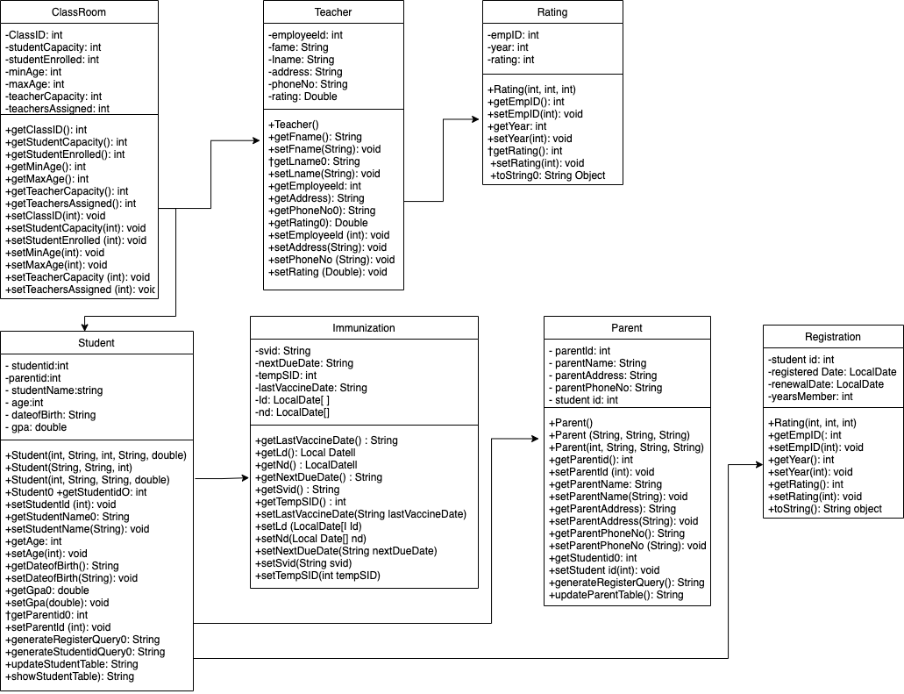
UML

Slide 5
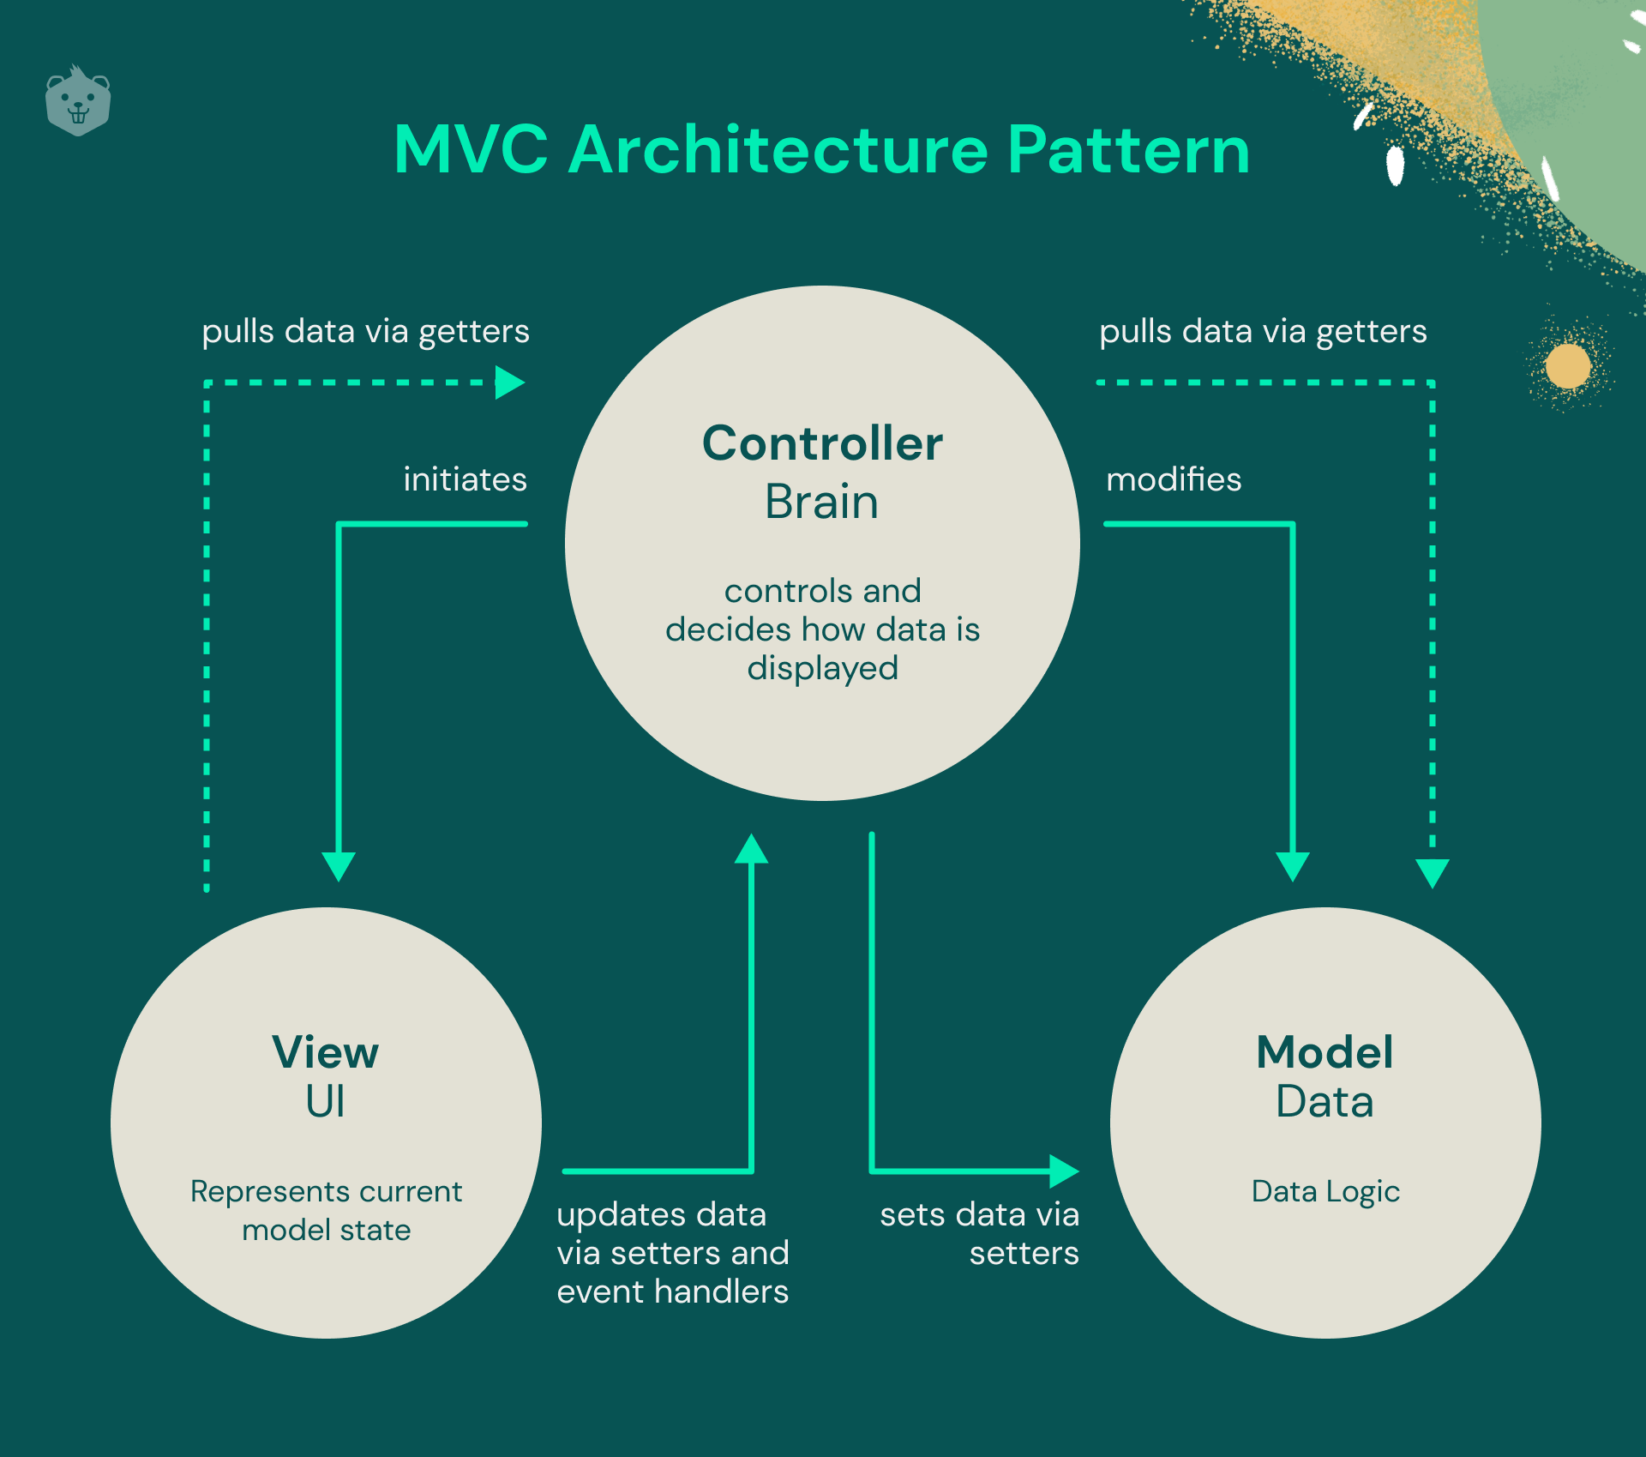
MVC

Slide 6
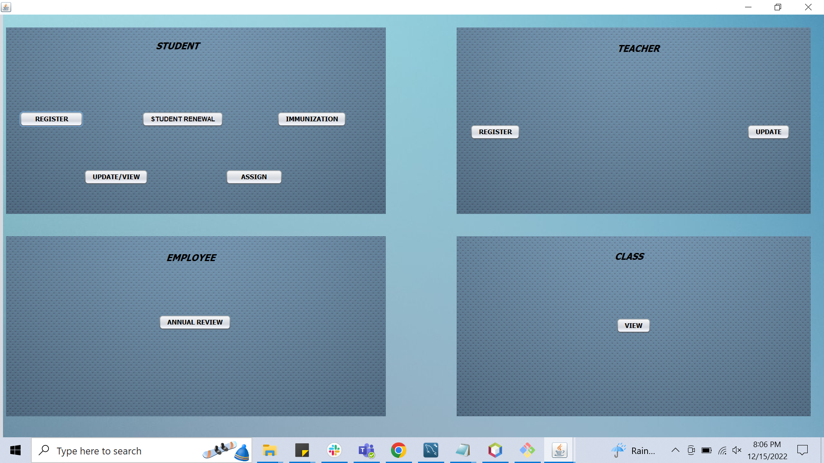
Home Screen

Slide 7
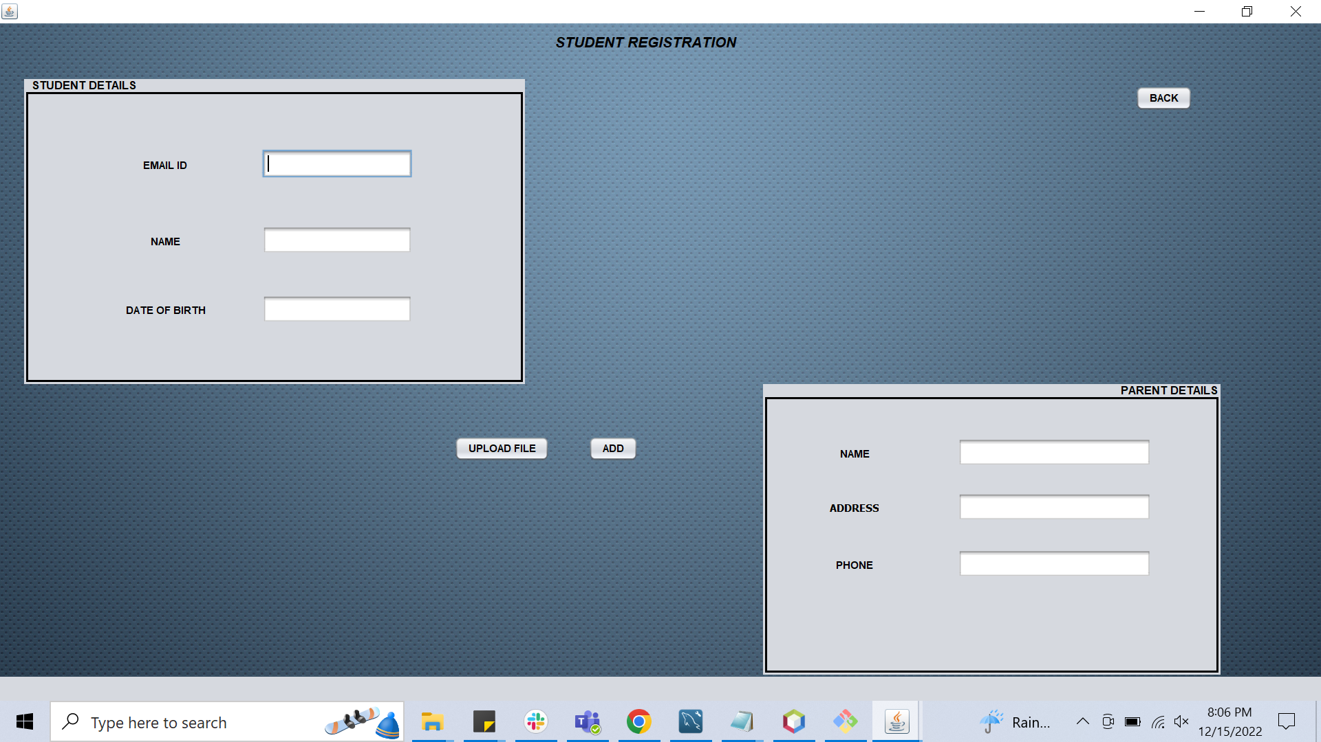
Student Registration

Slide 8
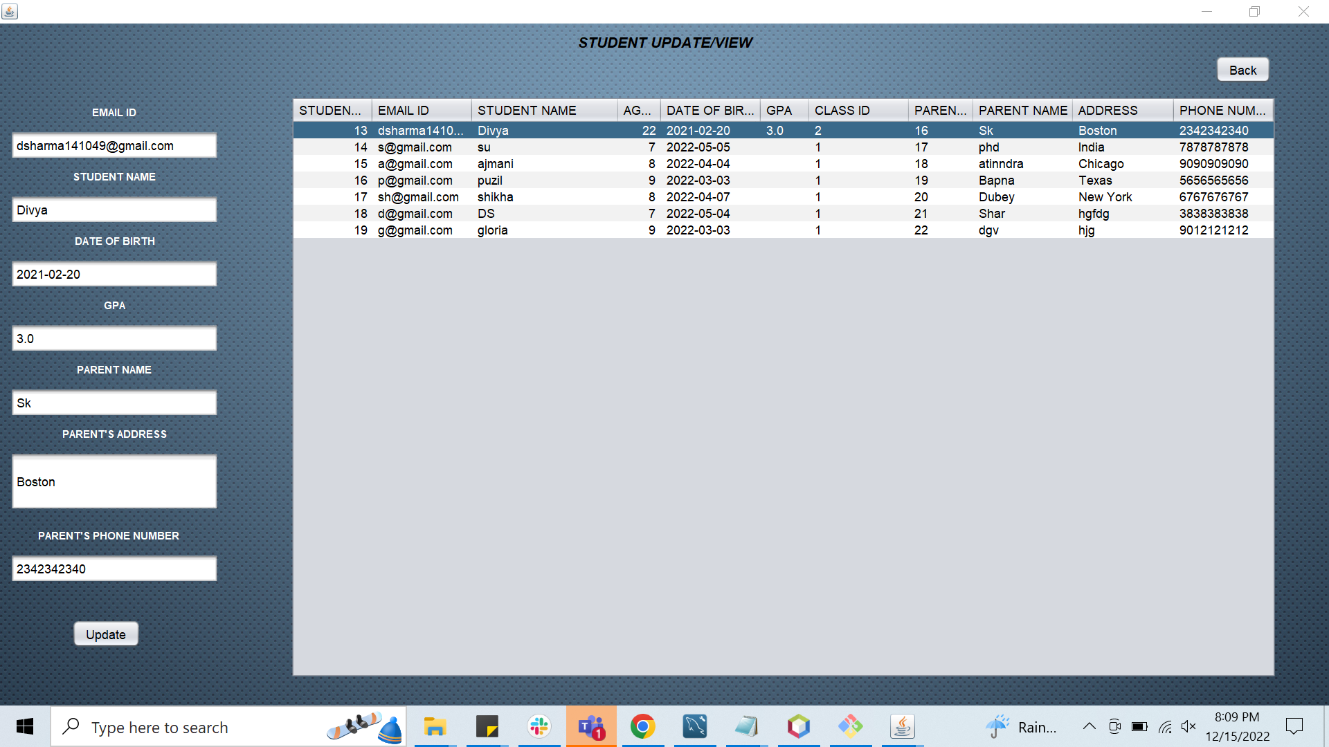
Student Update/Delete

Slide 9
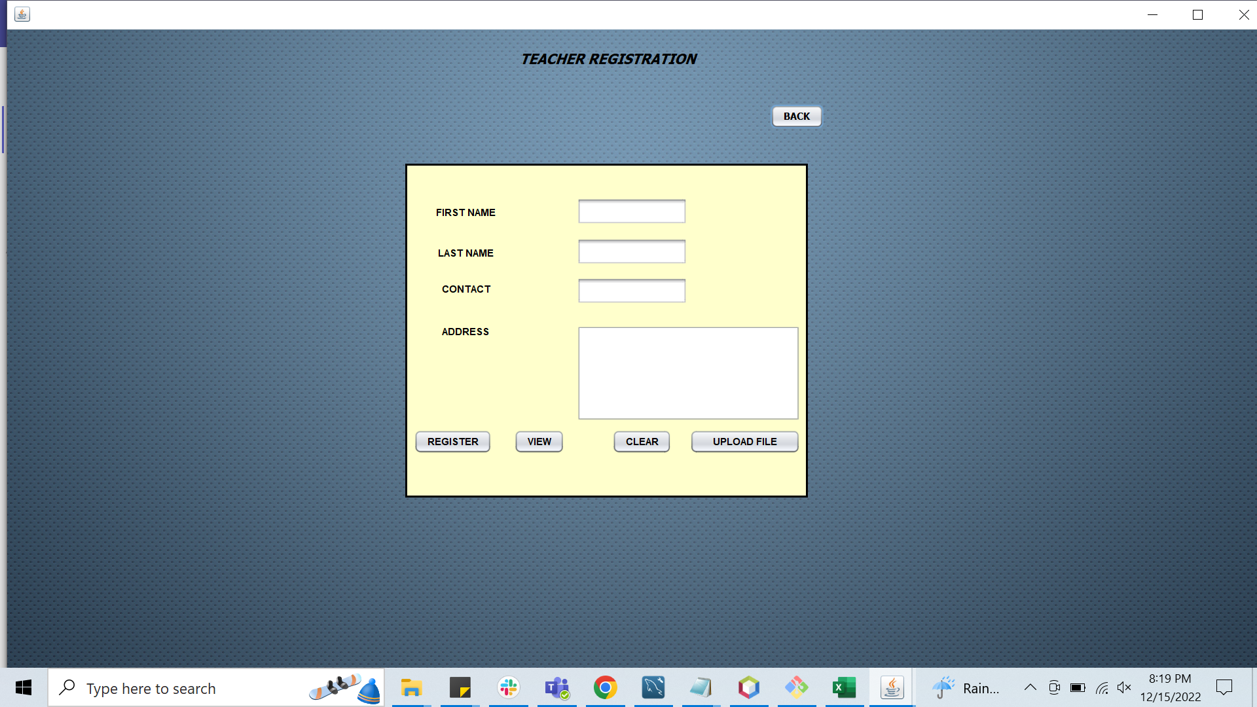
Teacher Registration

Slide 10
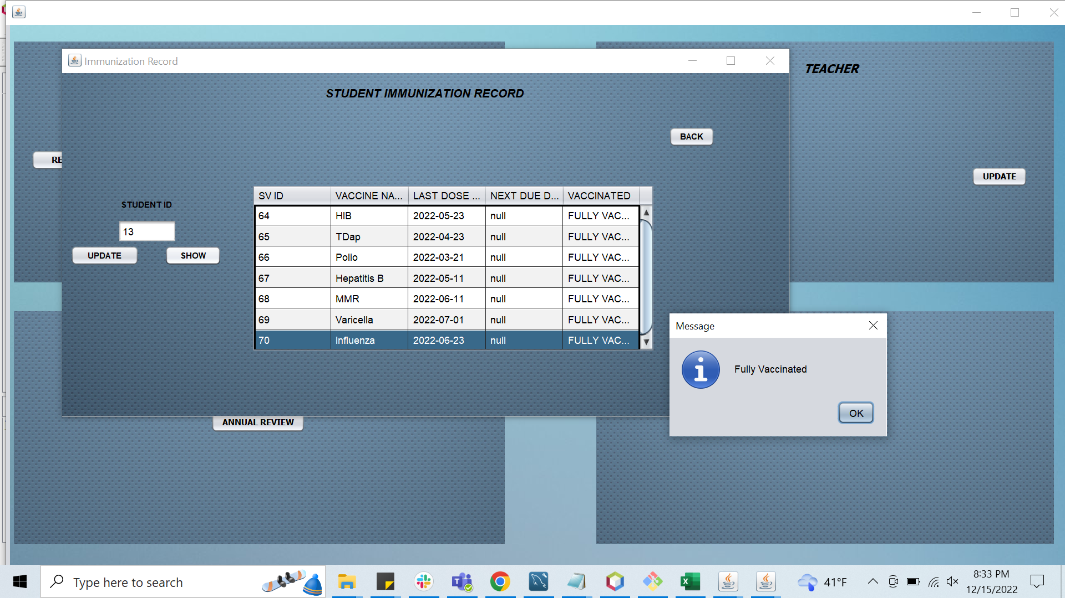
Student Immunization

Slide 11
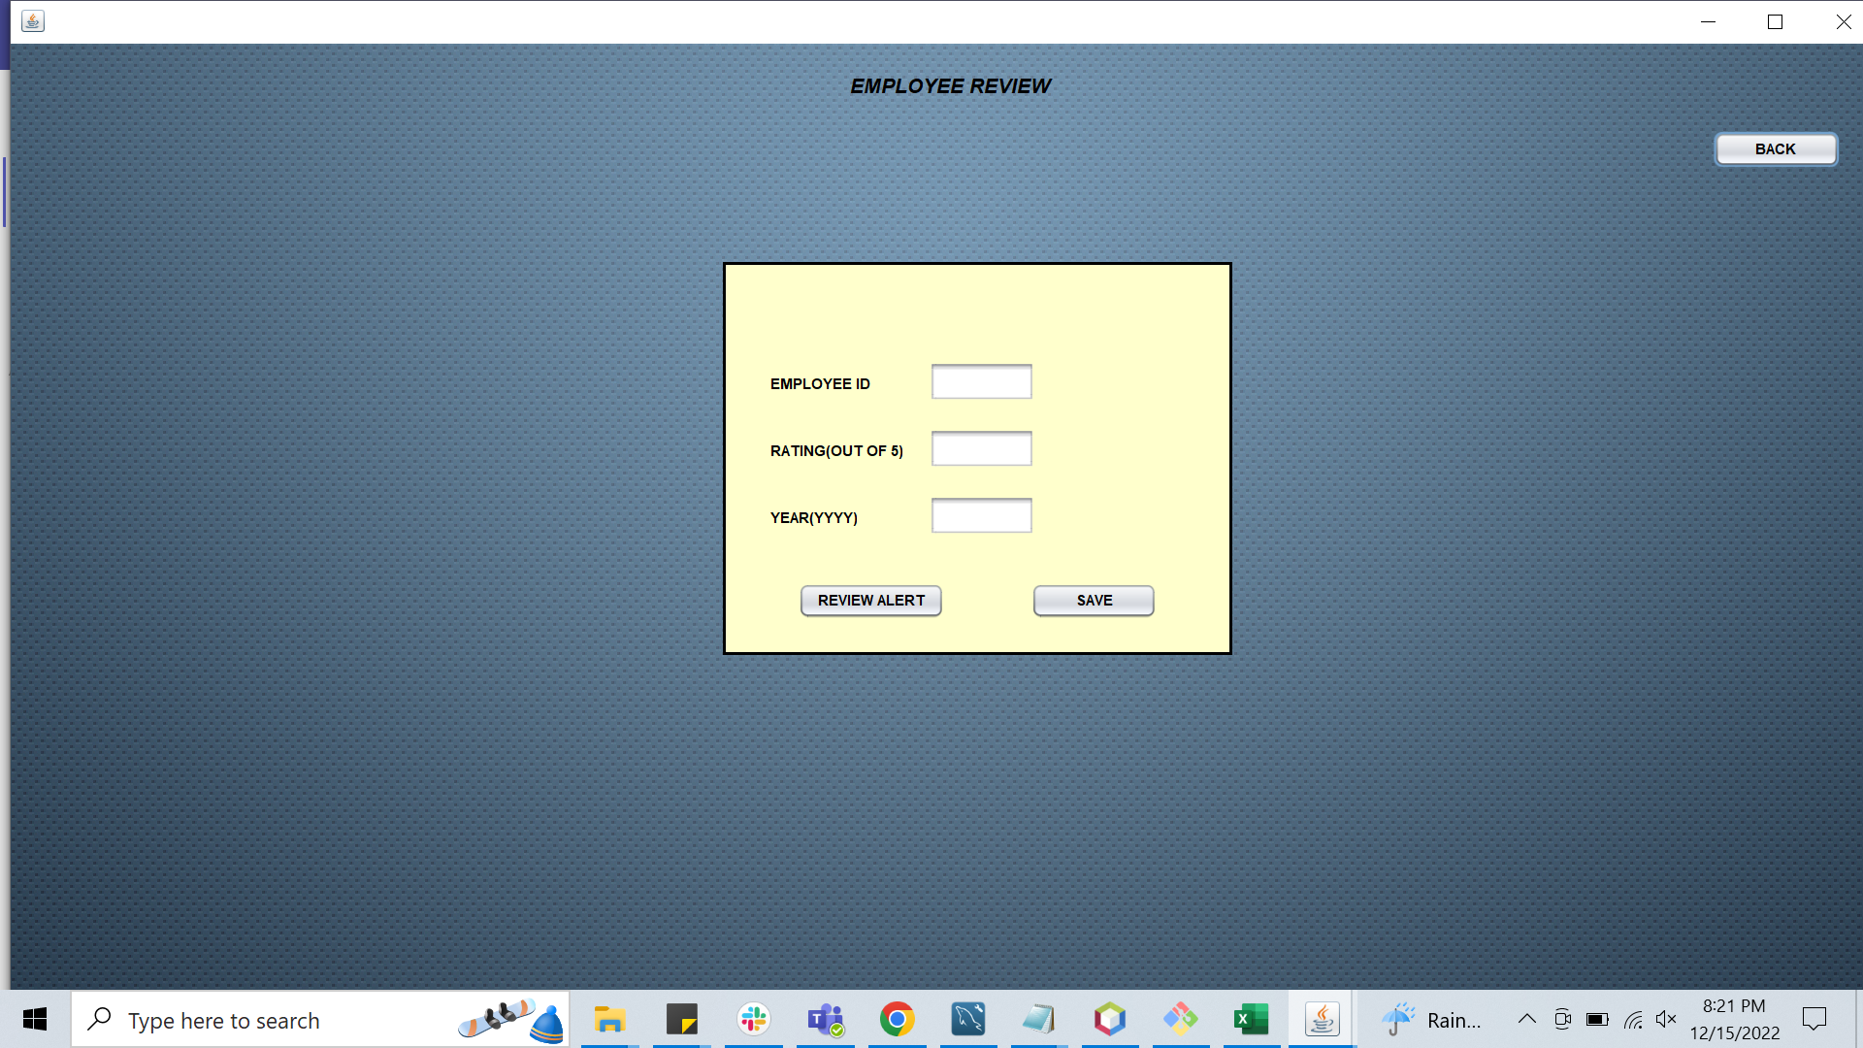
Employee review

Slide 12
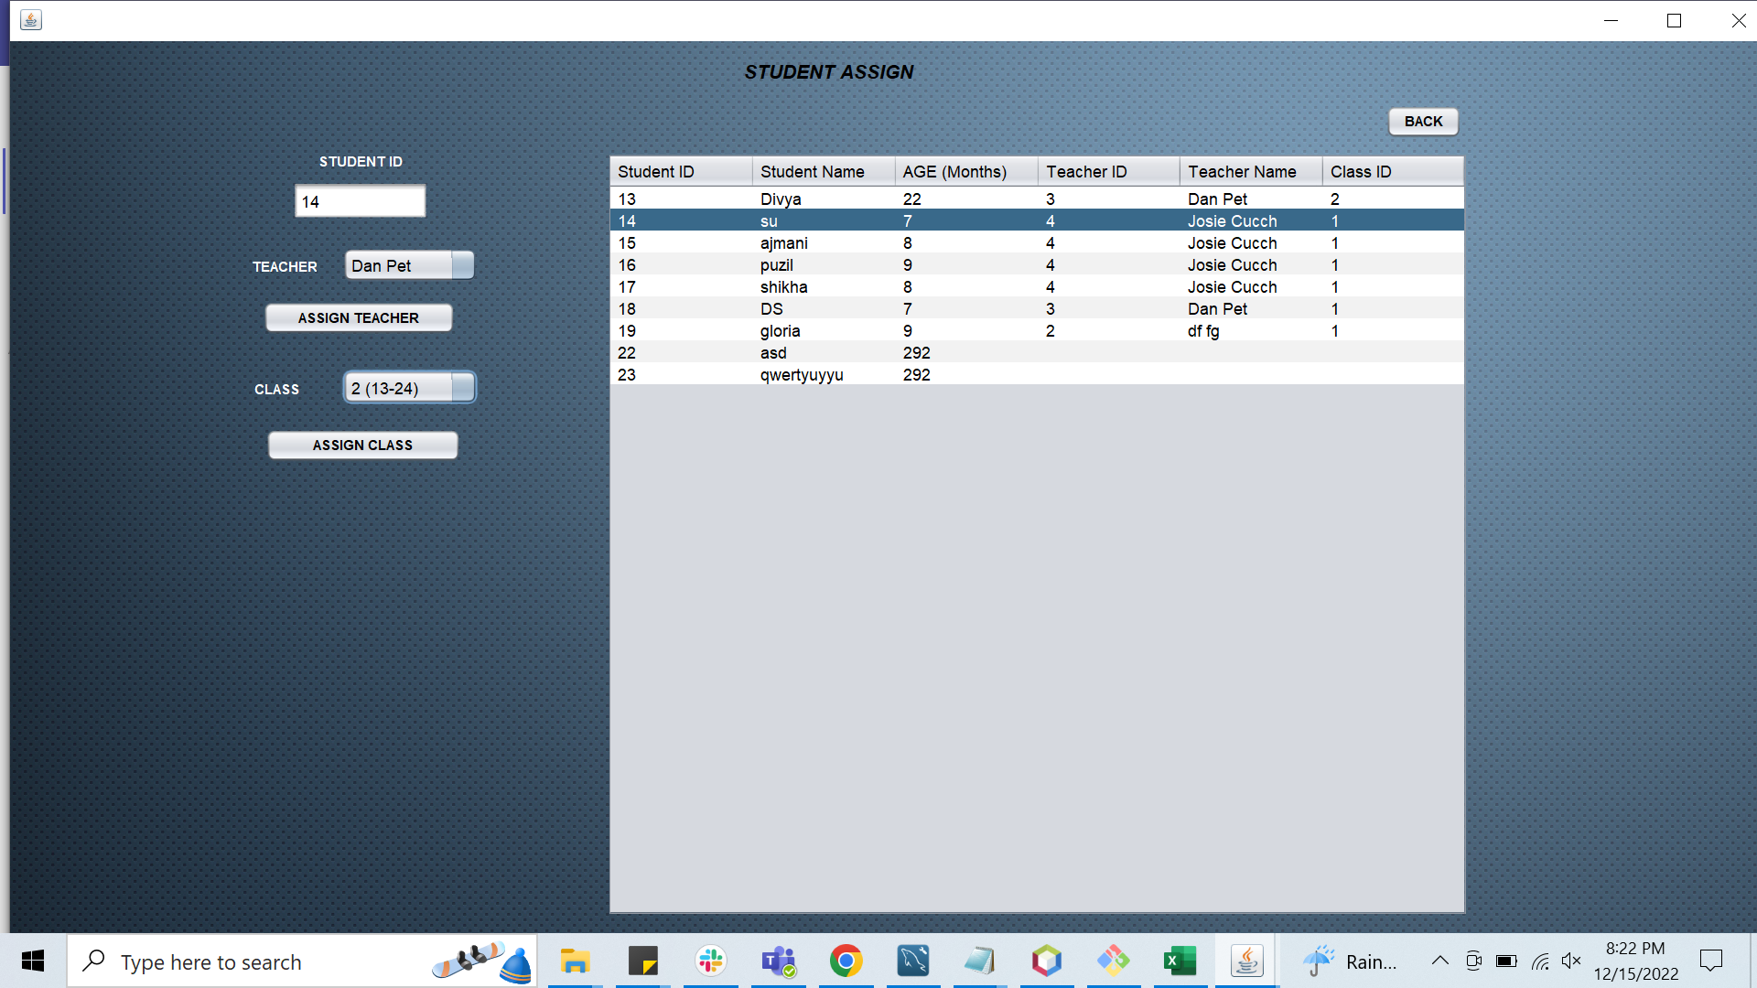
Student Assign

Slide 13
Future enhancements
Another feature that can be added is the ability to opt for multiple subjects by students.
Attendance management system integrated into an existing application.
Improvise modules to handle latency
Database integration using NoSQL DB.
Designing the UI in Java FX

Slide 14
Thank You

